Slide 1
MongoDB
SREELAKSHMI E NAIR UID : 161099 sreelakshmi.nair1@ust.com

Slide 2
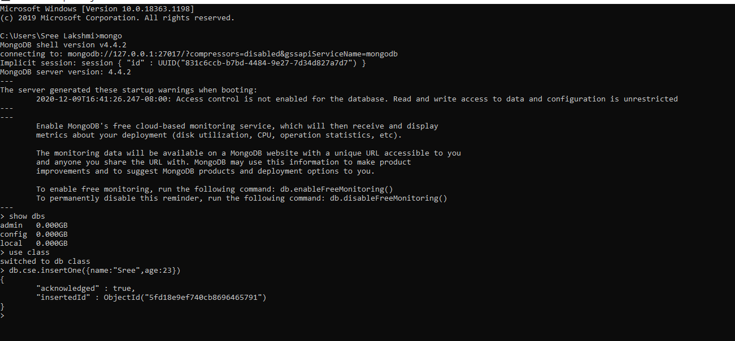
Switched to db class and inserted one document using insertOne

Slide 3

Reading Document using find()

Slide 4
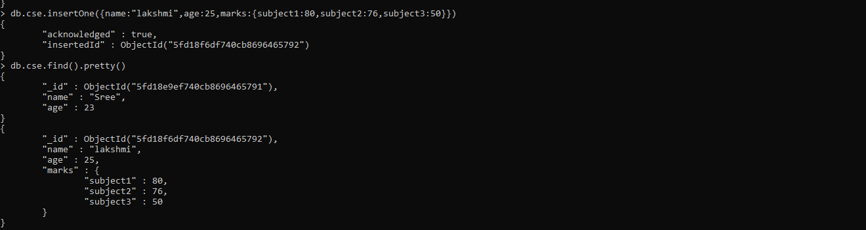
Inserting Nested Document and Reading the document

Slide 5
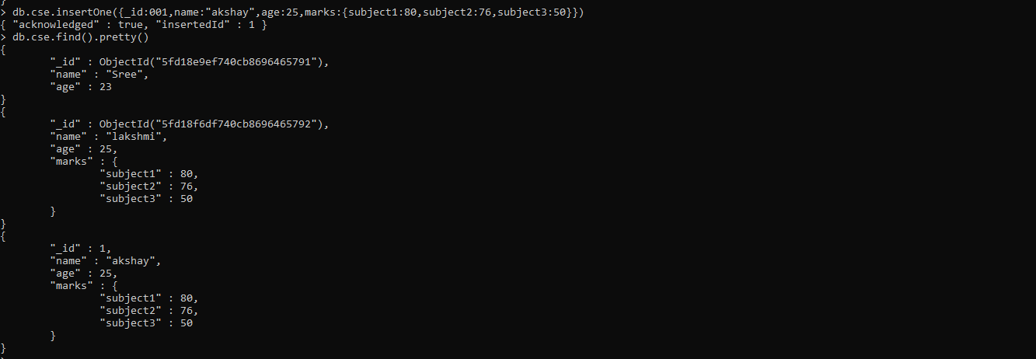
Insert with custom ID

Slide 6

Updating Single Document

Slide 7

Deleting single Document

Slide 8
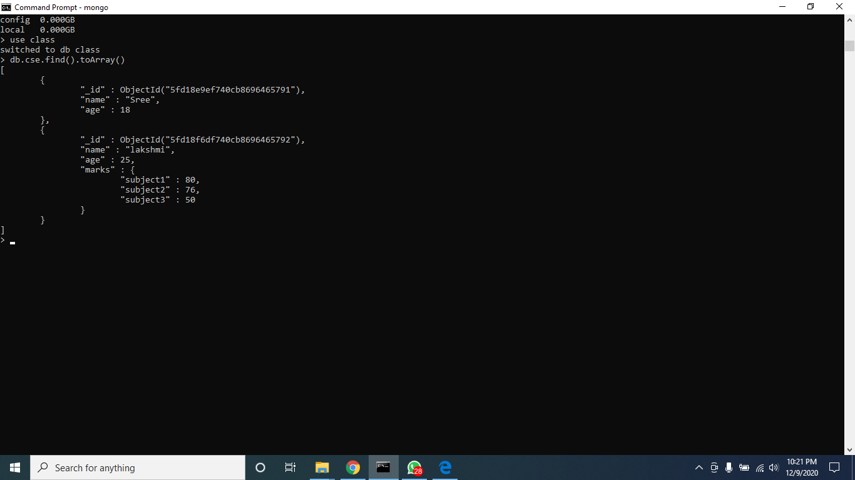
Reading Documents as array

Slide 9
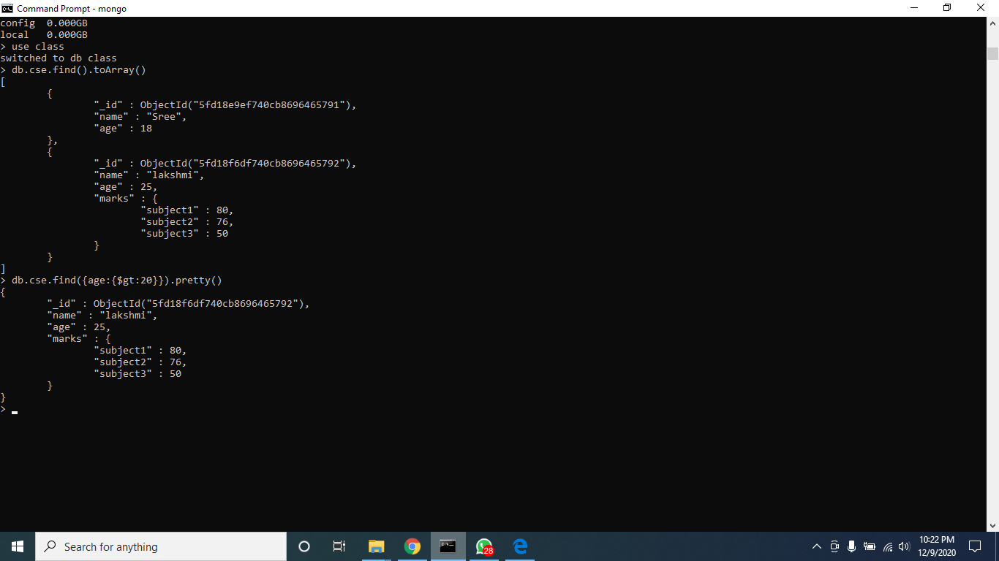
Reading Documents using particular condition

Slide 10
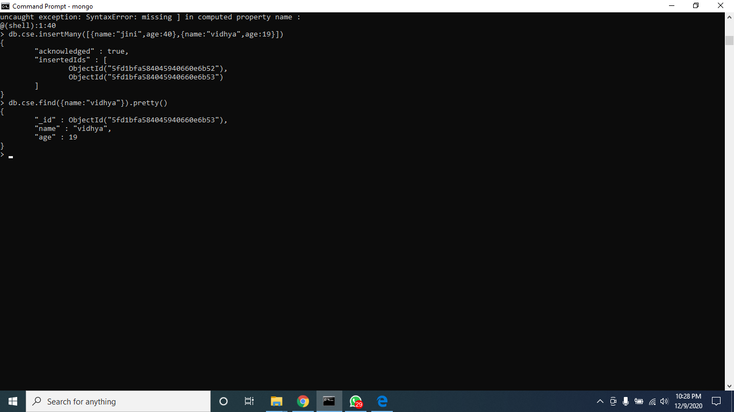
Inserting Many Documents and finding the Document with particular condition

Slide 11
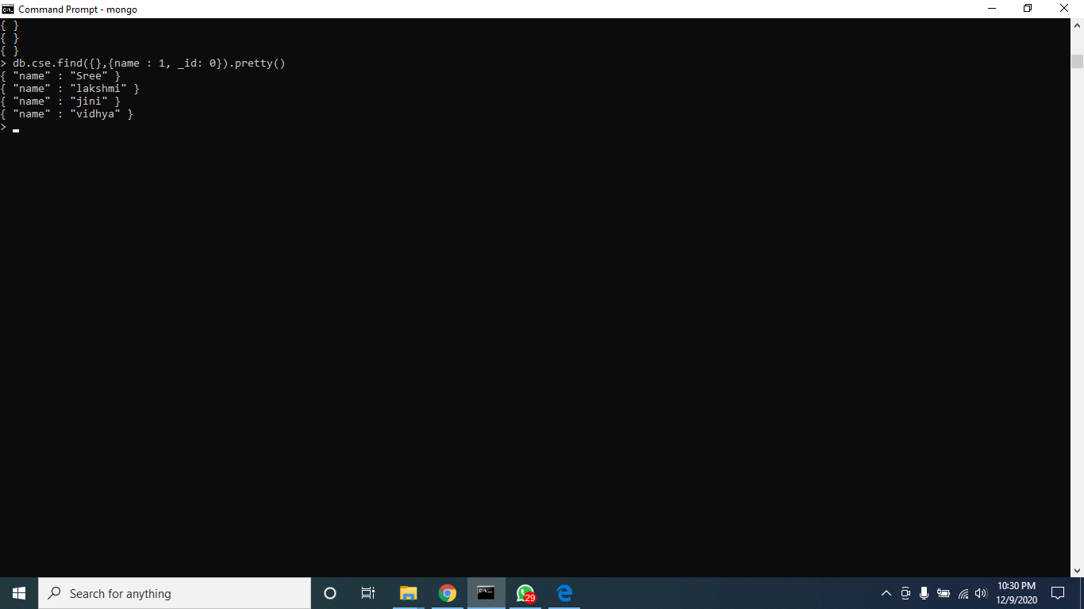
Reading Single column from Every Documents

Slide 12

Reading Nested Document

Slide 13

Updating Many Documents

Slide 14

Update without atomic operations

Slide 15

Replacing single Document

Slide 16
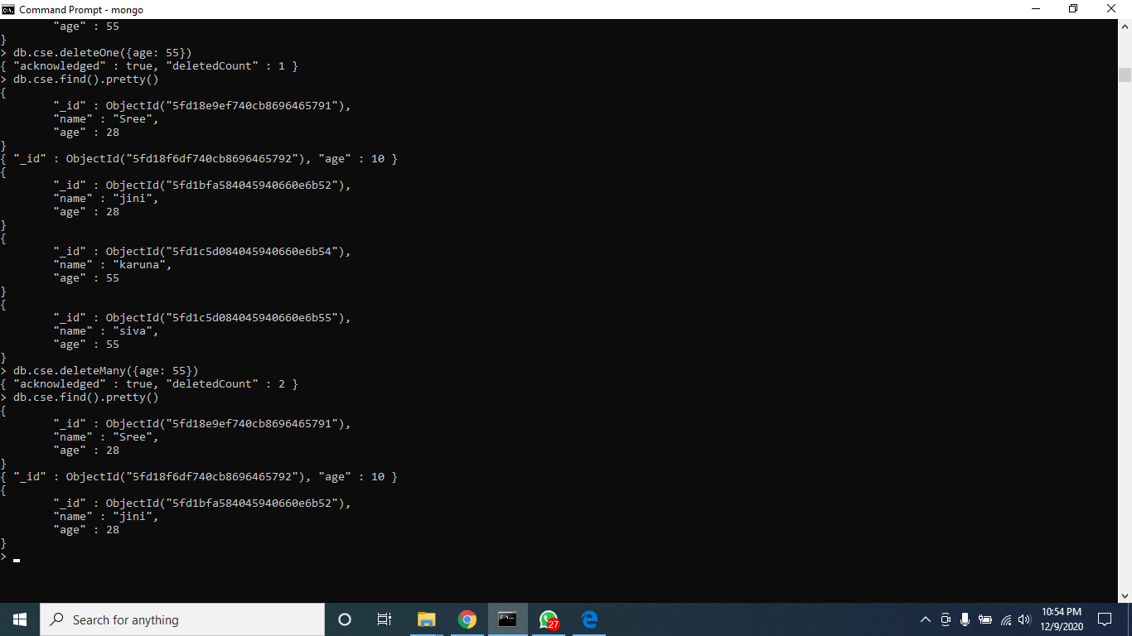
Deleting single Document and Deleting Many Documents

